Slide 1
University Admission System
Bangalore, 10 oct 2018, Team-

Slide 2
Objectives
Development of an University Admission System (UAS)
Search a university program
Apply for a university program
Facilitate administration staff with add/update/delete any program
Based on application data and interview, MAC can shortlist candidates

Slide 3
SDLC
Waterfall model
Requirements
Design
Implementation
Verification
Maintenance

Slide 4
Functional Requirements
Applicant
Member of admission committee (MAC)
Administration
View all programs scheduled by the university
Apply for a scheduled program of the university, by filling up the application details that auto generates the application ID
View the application status, based on the application ID
Login into the system using his/her credentials.
View applications for a specific program.
Accept/Reject an application on the basis of the details of the applicant. If accepted, fill in the scheduled date for an interview of the applicant before confirming the applicant to take the program.
After the interview, update the status of the application to Confirmed/Rejected
Login into the system using his/her credentials.
Update and manage (add or delete) information of the programs offer by the university
Manage (add or delete) schedules of the programs offered by the university
View list of applicants confirmed/ accepted/rejected for a scheduled program.
View list of programs scheduled to commence in a give time period

Slide 5
Non-Functional Requirements
Secure Access of required data
User friendly experience and interface
Performance of application

Slide 6
System Requirements
Software requirements
Hardware Requirements
Click to insert title
Microsoft Windows 95, 98, or NT 4.0, 2k, XP, Windows 7
Oracle 9i client and access to oracle 9i server
JDK 8
Eclipse Luna
JUnit 4.0
Intel Pentium 90 or higher (P166 recommended)
Memory: 32MB of RAM (64MB or more recommended)

Slide 7
Technology Used
Web Components
Java Classes would be designed for this purpose
Business Logic Components and Services
Java Beans
Databases
Oracle 9i

Slide 8
System Modules
Student
MAC
Admin
Apply For Program at University
Login
Login
View Application Status
View Applications
Add new offered program
Delete offered program
Accept/Reject Application
Add new scheduled program
Post Interview Updation
Delete scheduled program
View Applications
View scheduled programs

Slide 9
Database Integration
DBMS Software Used
Oracle 9i
Relational Database
Tables
SQL or JDBC
Dao Layer
DBMS
Data
Data
SQL or JDBC
Data
Users
Database
Name of Database Table | Description
Application | Data of Applied students
Users | Login credentials data
Programs Offered | Data of offered programs
Programs Scheduled | Data of scheduled programs
Participants | Data of accepted applicants

Slide 10
Layered Architecture
In layered architecture, business rules, behavior, and data are obtained and manipulated, based on activity via the user interface.
Layered architecture provides a clean separation between the business implementation, presentation and data-access logic
Presentation Layer
Application UI
Domain
Objects
Service/Business Logic
Layer
Service Interfaces
Service Implementation
Data Access Layer
DAO Interfaces
DAO Implementation
Database
Notes:
Use of Layered architecture is one of the architectural pattern based on call-and-return style

Slide 11
Layered Architecture
Layers :
Domain Objects
com.capgemini.university.bean
Presentation Layer
com.capgemini.university.ui
Business Layer /Service Layer
com.capgemini.university.service
Data Access Layer
com.capgemini.university.dao
Exception Handling
com.capgemini.university.exception

Slide 12
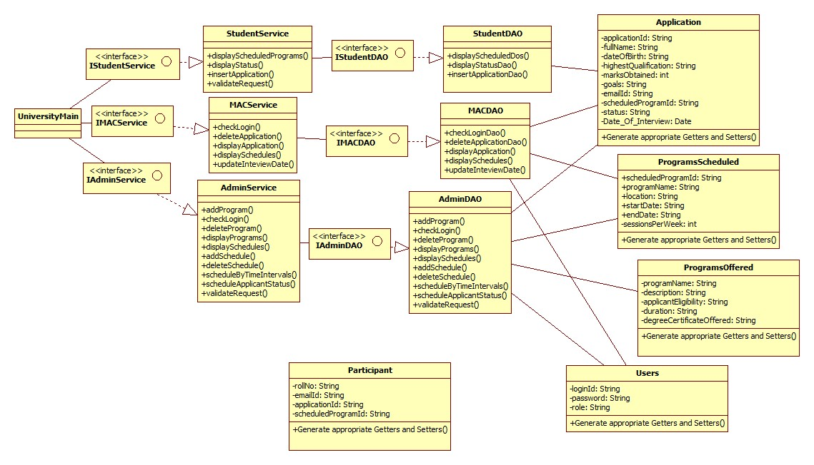
Class diagram

Slide 13
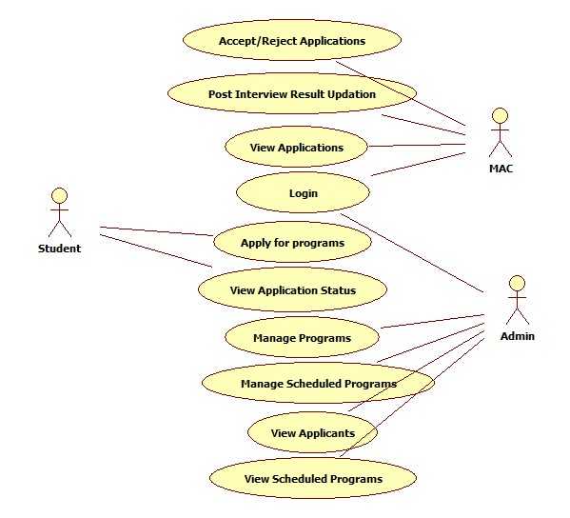
Use Case Diagram

Slide 14
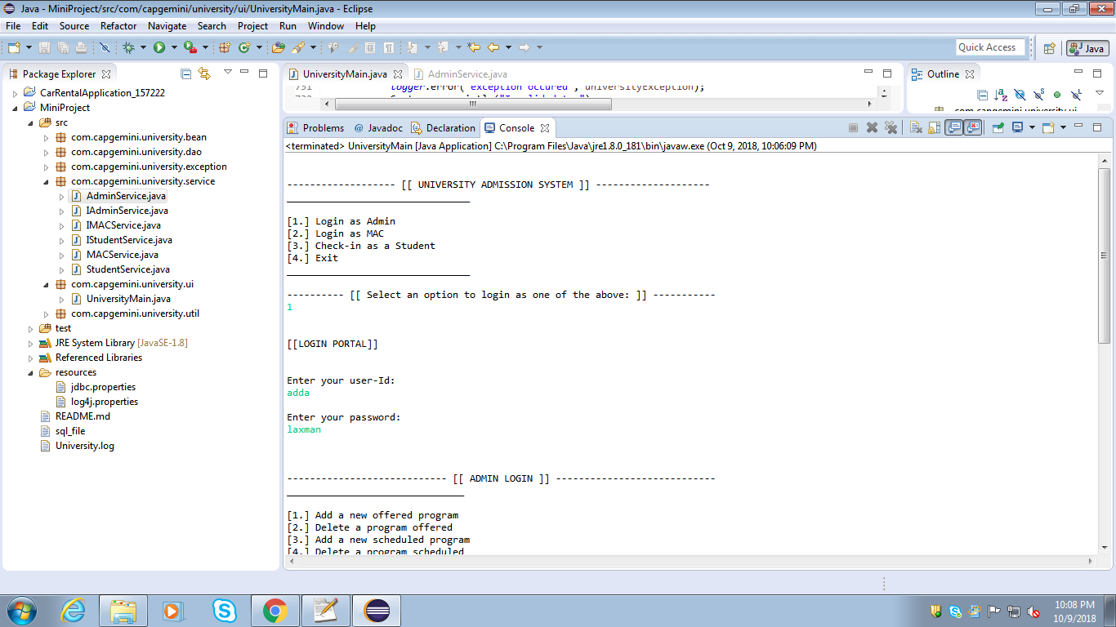
Main Page

Slide 15
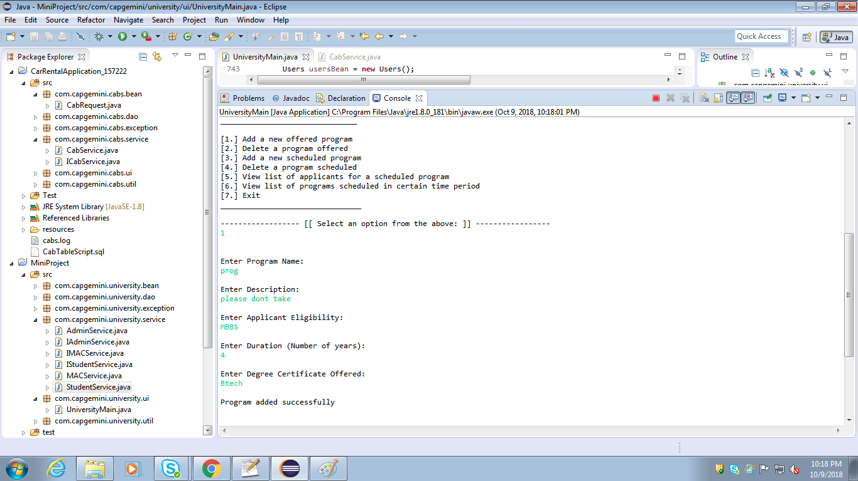
Admin

Slide 16
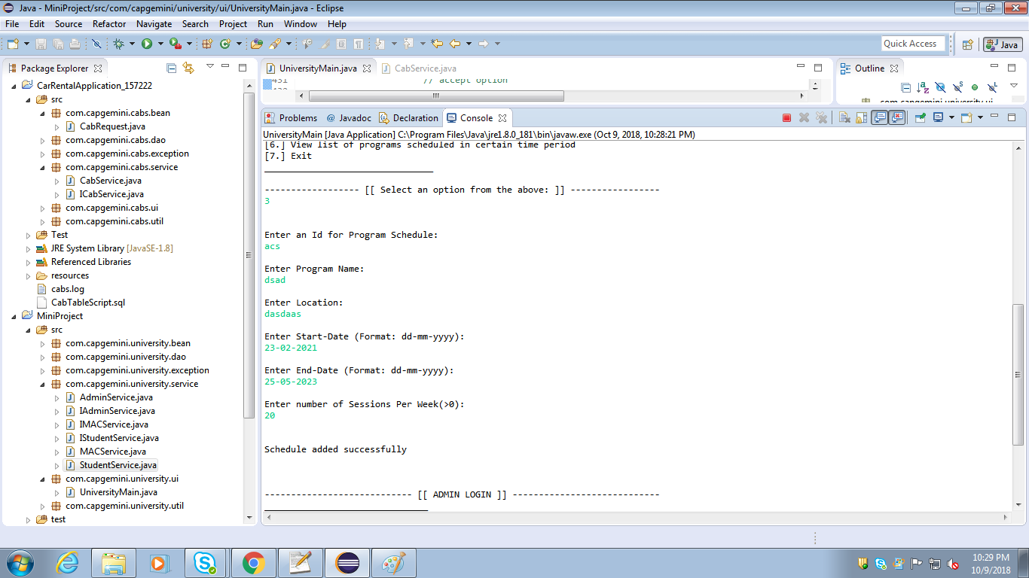
Admin

Slide 17
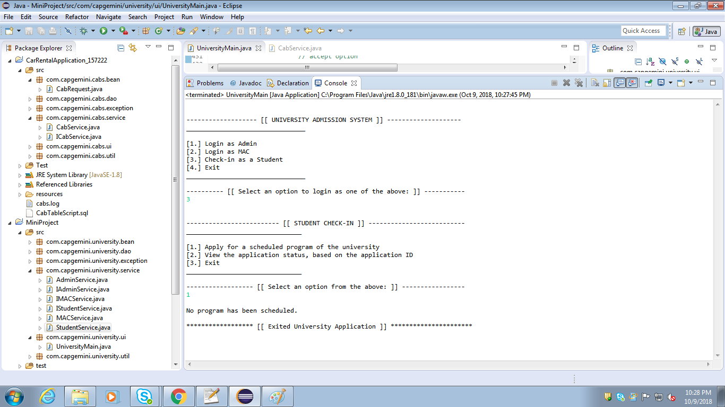
Student

Slide 18
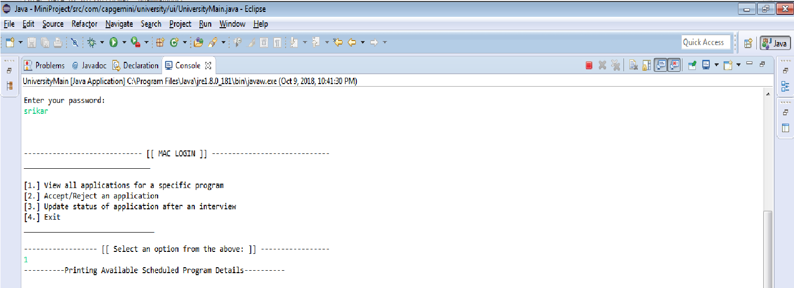
MAC

Slide 19
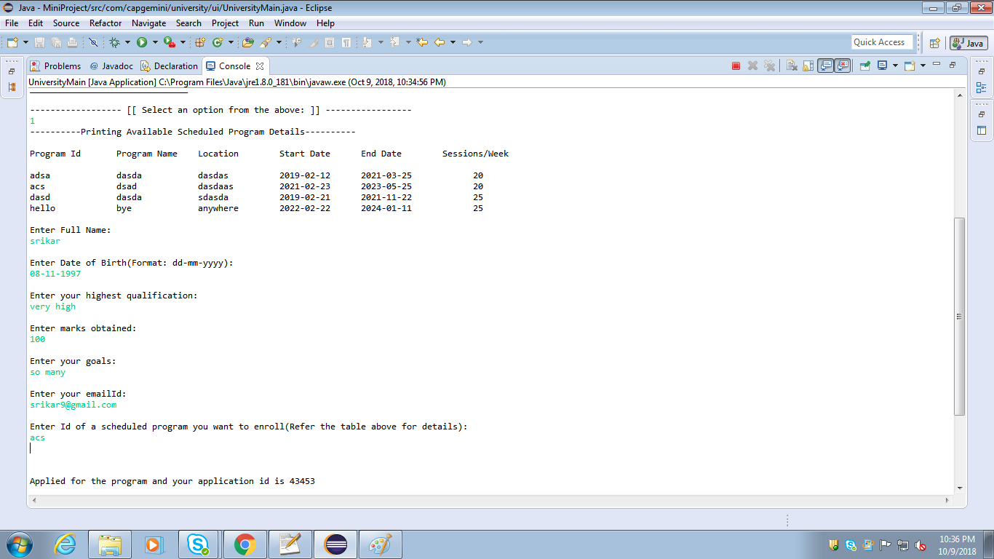
MAC

Slide 20
Loggers
JAVA Logging
Logging is writing the state of a program at various stages of its execution to some repository
Log4j is an open source logging API for Java
Application
logger
handler
outside

Slide 21
JUnit
Testing framework for JAVA
A free, open source, software testing framework for Java.
A library put in a jar file.
Not an automated testing tool.
JUnit tests are Java classes that contain one or more unit test methods

Slide 22
Future Scope
Integration with HTML pages to create a website
Java Web Application is used to create dynamic websites
Java provides support for web application through Servlets and JSPs

